Slide 1
VPR Assessment of a Novel Partitioning Algorithm
David Munro
Supervisor: Oliver Diessel

Slide 2
Overall Goal
To implement the partitioning algorithm and assess the results using Versatile Place and Route (VPR) and MCNC benchmarks.
VPR used as it’s open source.

Slide 3
Overview
What are we partitioning and why?
FPGA’s are useful for space based applications due to low cost, wide availability, etc. [1].
Downsides include increased susceptibility to radiation induced errors[1]. For Virtex 4 in geosynchronous orbit, predicted mean time between errors is only 1.4s[2].
Use Triple Modular Redundancy (TMR) to detect errors.

Slide 4
Triple Modular Redundancy
Make three copies of a circuit, and feed the outputs to a voter.
Once an error is detected we can fix it by e.g. selectively reconfiguring the incorrect module.
Clock frequency, pipeline length and circuit area all affect recovery time.
Need to detect, reconfigure and resynchronise within error rate.
TMR Module 1
Voter
Dout₁
TMR Module 2
Din
Dout₂
Dout
TMR Module 3
Bad
TMR Module 3
Dout₃
Source Cetin & Diessel (2012)
Notes:
Triple Modular Redundancy (TMR) is a popular approach to mitigating the effects of SEUs
The user design is triplicated and the outputs from each module are fed into a voting circuit to determine the correct output value
TMR significantly improves system reliability and availability in the presence of SEUs
However, TMR results in substantial overhead in terms of area and power consumption.
selective/partial TMR and voter insertion has been used to minimize the overheads associated with TMR, in terms of area, clock speed and power consumption
Comes at the cost of reduced system reliability and availability, which may be undesirable for some applications

Slide 5
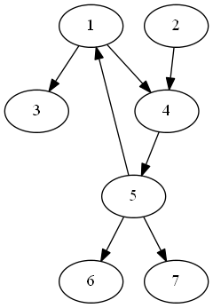
Partitioning in action
Start with inputs.
Add nodes in a breadth first manner.
Continue until area, frequency or critical path exceeds threshold.
Max recovery time | Estimated recovery time | Area | Critical Path | Frequency
1.00E-08 | 1.00E-09 | 20 | 1 | 100MHz
Max recovery time | Estimated recovery time | Area | Critical Path | Frequency
1.00E-08 | 5.00E-09 | 30 | 2 | 64MHz
Max recovery time | Estimated recovery time | Area | Critical Path | Frequency
1.00E-08 | 2.00E-08 | 40 | 2 | 50MHz
TMR-ify node-set.
Repeat process until all nodes are TMR’d.
Partitioning wavefront

Slide 6
Partitioning Considerations
To do this, need a way of efficiently calculating area, frequency and pipeline length for a set of nodes.
Pipeline length is trivial, the other two not so much.
No way to tell until design is routed, which takes too long, therefore we need some way of estimating.
Also, to effectively traverse, need circuit as a graph. VHDL/Verilog too high level, needs to happen post-synthesis, somewhere in CAD flow.

Slide 7
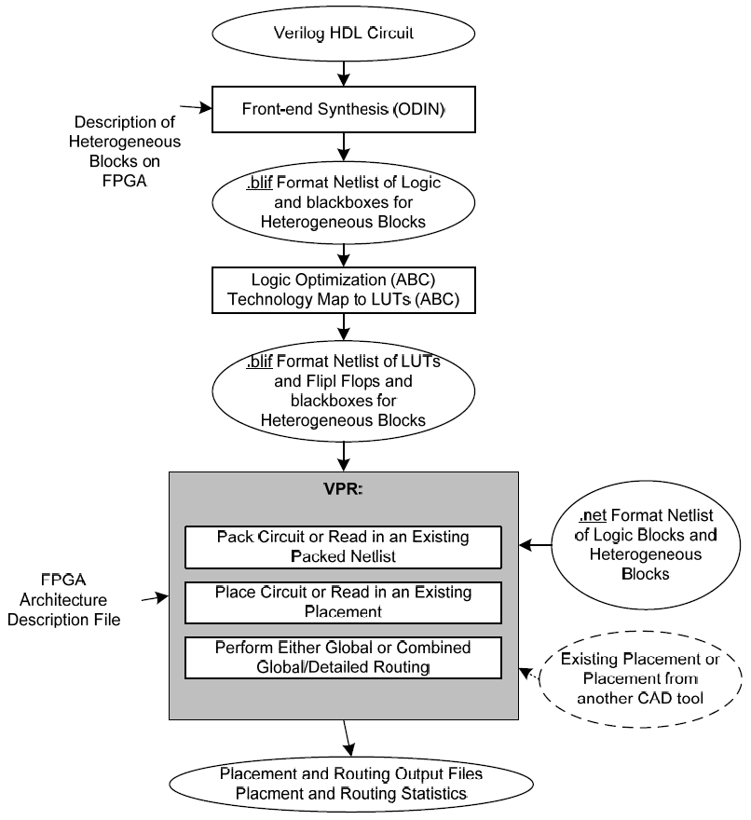
Versatile Place and Route (VPR)
Open source.
Open file formats.
Want to partition as late as possible.
Adding elements means routing and placing again => partition just before or after packing.
Before packing is easier, but might be less effective.
Picture of CAD design flow. Sourced from VPR manual
Notes:
Explain what happens at each step.

Slide 8
Input File
Read blif file into in-memory graph.
Partition graph.
Insert voter logic into blif file as appropriate.
File format is text input of inputs, outputs and logic elements.
Only logic elements supported or Look Up Tables (LUT) and latches.

Slide 9
Current Progress
TMR arbitrary user specified subcircuit preserving surrounding circuit.
Just need to automate subcircuit selection, instead of user defined.
To do that need way of estimating area/timing from set of nodes.
Place and Route circuit in VPR
TMR circuit using our algorithm
Place and route TMR version
Compare TMR and non TMR version

Slide 10
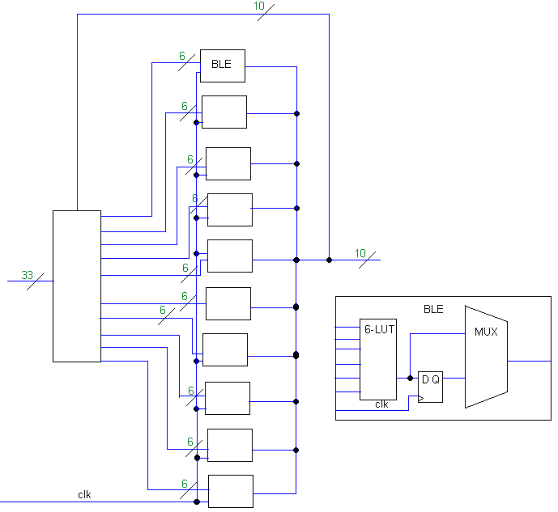
Architecture
Use imaginary standard architecture, somewhat similar to Virtex 5.
FPGA are and routing channels grow to accommodate design.
Customisable, so can make more accurate to target a specific platform.
CLB and BLE layout

Slide 11
Benchmarking
Two things we’re looking at.
1. Comparing circuits with and without TMR, as per thesis title.
2. Trying to find a relationship, or suitable guesses, for our partitioner.
For now we are calculating minimum channels and area to look at general trends. Later we look at the case where we are close to channel/area capacity.
Circuits used are MCNC (Microelectronics Centre of North Carolina) benchmarks, provided by the VTR (Verilog To Routing) Project.

Slide 12
Results
Quite close to initial guess.
Area requirement slightly greater than tripled.
Mean increase in critical path time is 6.9E-10s. Max is 1.87E-09s increase to 8.28E-9s (156MHz->121MHz max frequency)
Name | .latch | .names | FPGA Area | Estimated Critical Path Latency | Channel Width | Av. Wire Segments | Used Logic Block Area | Critical Path
pdc | 0 | 13765 | 44 | 7.46E-09 | 72 | 7.74884 | 2.04E+07 | 8.28E-09
misex3 | 0 | 4205 | 24 | 5.12E-09 | 50 | 5.86212 | 6.24E+06 | 5.27E-09
s38417 | 4389 | 18232 | 51 | 6.39E-09 | 50 | 3.96346 | 2.84E+07 | 6.80E-09
pdc TMR | 0 | 4575 | 25 | 5.47E-09 | 64 | 7.8308 | 6.78E+06 | 6.41E-09
misex3 TMR | 0 | 1397 | 14 | 3.73E-09 | 42 | 5.74857 | 2.07E+06 | 4.29E-09
s38417 TMR | 1463 | 6042 | 30 | 5.91E-09 | 42 | 4.02152 | 9.42E+06 | 6.32E-09

Slide 13
Results – Estimating Area
We also care about estimating area and latency from a DFG.
Clear relationship between nodes and area.

Slide 14
Results – Estimating Time
Much harder to estimate time before placement.
Options:
Guessing. Guided by number of blocks or pre-TMR time, may not be entirely inaccurate.
Partial placement. Placer uses simulated annealing, so run very rough placement to get estimate [3].
Partition after placement. Better knowledge, much harder to do.
Notes:
Pre-TMR time, so place original circuit, add scale factor from benchmarking, then assume that’s the subcircuit frequency and calculate delay off that constant frequency times pipeline length.

Slide 15
What Next?
Using very basic and arbitrary estimation functions for area and timing, implement partitioning.
Improve estimates.
Timeline, not including holidays

Slide 16
References
[1] E. Cetin and O. Diessel, ”Guaranteed Fault Recovery Time for FPGA-based TMR Circuits Employing Partial Reconfiguration”. In 2012 DAC Workshop 2nd International Workshop on Computing in Heterogeneous, Autonomous ‘N’ Goal-oriented Environments (CHA’N’GE), 2012.
[2] P. J. Pingree, “Advancing NASA’s on-board processing capabilities with reconﬁgurable fpga technologies,” in Aerospace Technologies Advancements, T. T. Arif, Ed. In Tech, Jan. 2010, ch. 5, pp. 69–86.
[3] Luu Jason, et al. “VPR User’s Manual”, Jan. 2012.
[4] V. Betz, J. Rose & A. Marquardt. “Architecture and CAD for deep-submicron FPGAs,” 1st Edition, March 1999 Springer.

